Slide 1
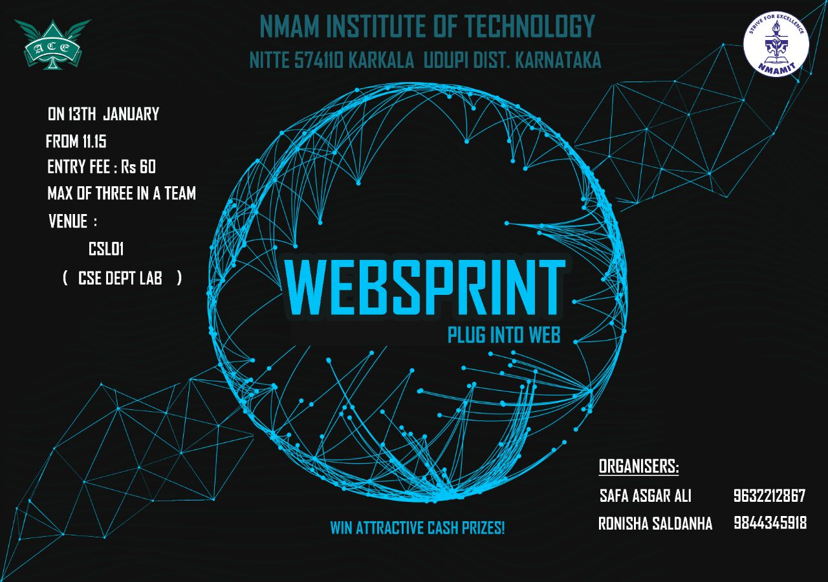

Slide 2
An Idea Can Change The World!
This round is all about designing a complete system that will have a practical use.
A common topic will be provided to all the teams!
Frameworks may be used.
Usage of Internet is strictly not allowed.
Violation of the above rule will lead to reduction of marks.
Necessary pictures will be provided.

Slide 3
TOPIC
The topic is – ONLINE TRANSPORTATION MANAGEMENT SYSTEM FOR NMAMIT,NITTE
The UI part must be a webpage.
The Back end may be anything of your choice.

Slide 4
REQUIREMENTS
Easy to use UI
Rules and regulations
Contact us Page
Feedback Section
Login For Multiple Administrator
Registering details
Payment module
Generate printable bus pass(photographs included)
Generate duplicate bus pass
Keep track of all students, faculty, buses and drivers.
Based on the availability of seats and routes predict the bus.
Mechanism to handle the details of students after 4 years.
THE MORE FUNCTIONALITIES – THE MORE IS THE SCORE!!!!

Slide 5
Thank you!!!!

